Slide 1
Project 1
IT Ticketing Application

Slide 2
Project Goals
User Goals
-Log in to application using company credentials
-View tickets currently open
-Create new tickets
-Log out

Slide 3
Project Goals part 2
IT Staff
-Log into application
-Main screen show all open tickets
-Be able to edit specific tickets on button click
-Edit notes for open tickets and close tickets
-Log out

Slide 4
Resources Used
Java EE
Maven
JDBC
Tomcat
HTML
JS
CSS
Docker
JAX-RS

Slide 5
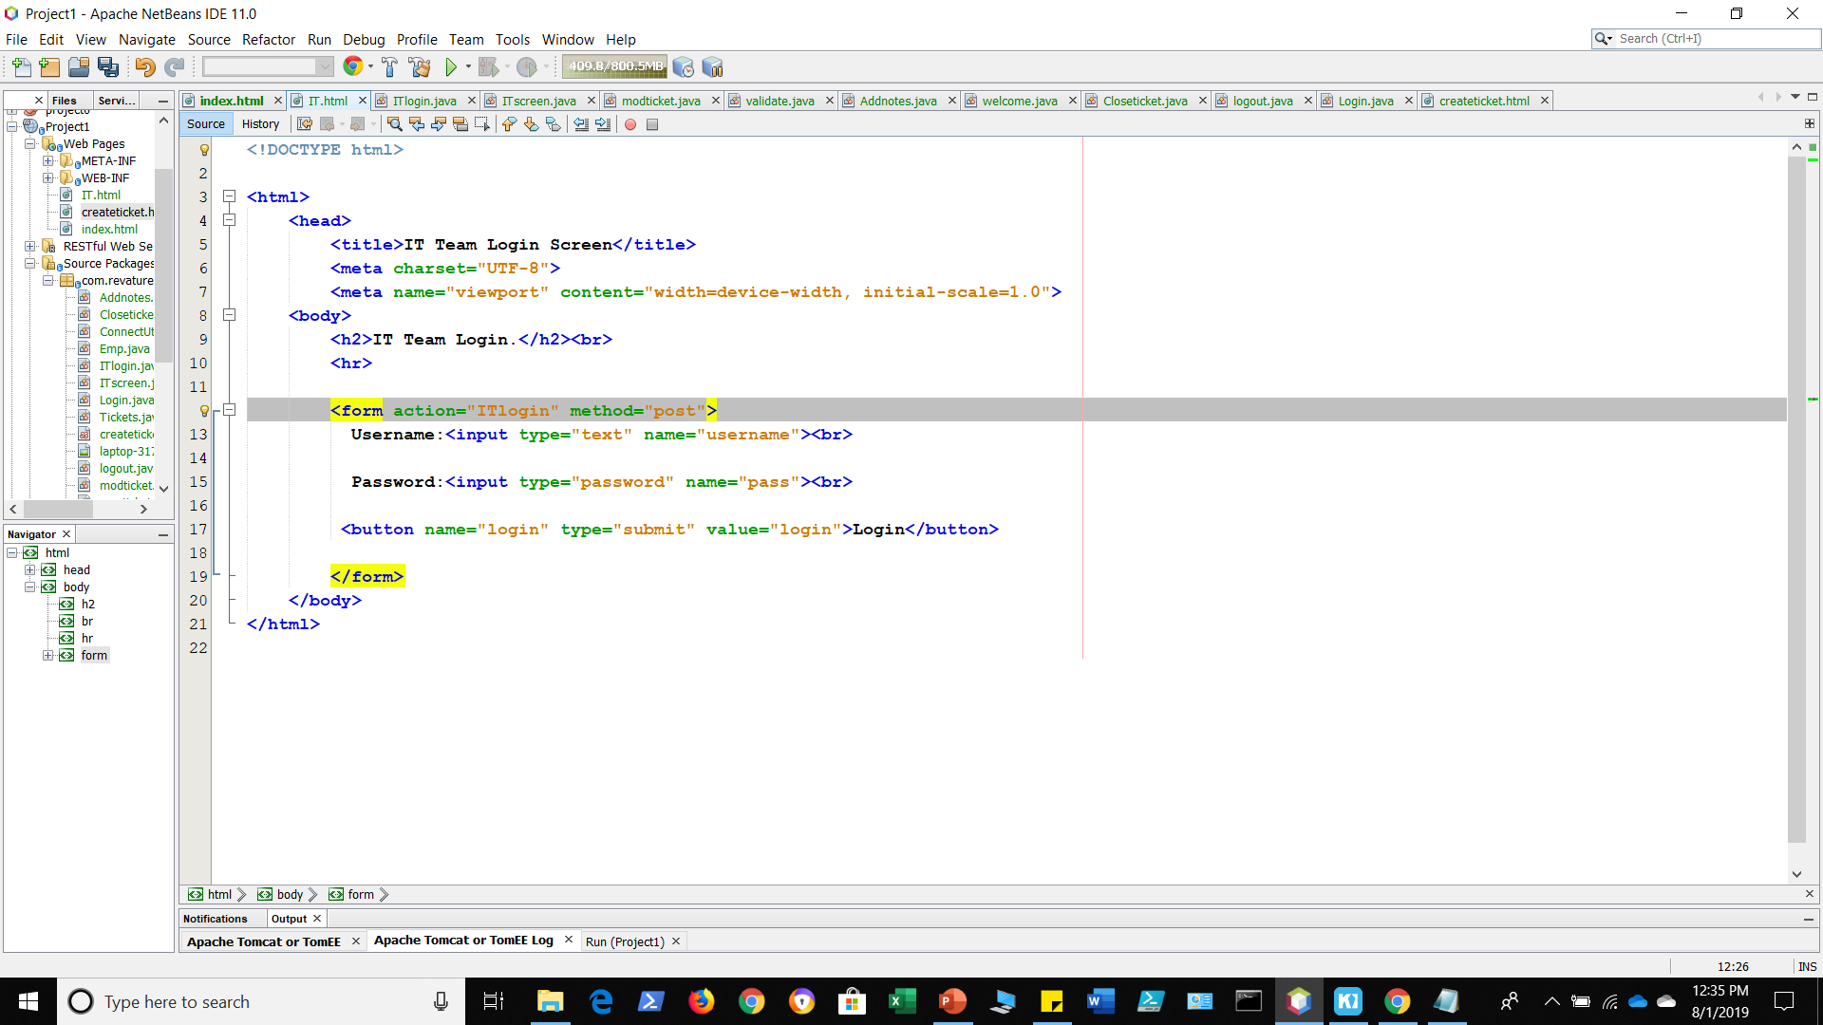
HTML-IT Login

Slide 6
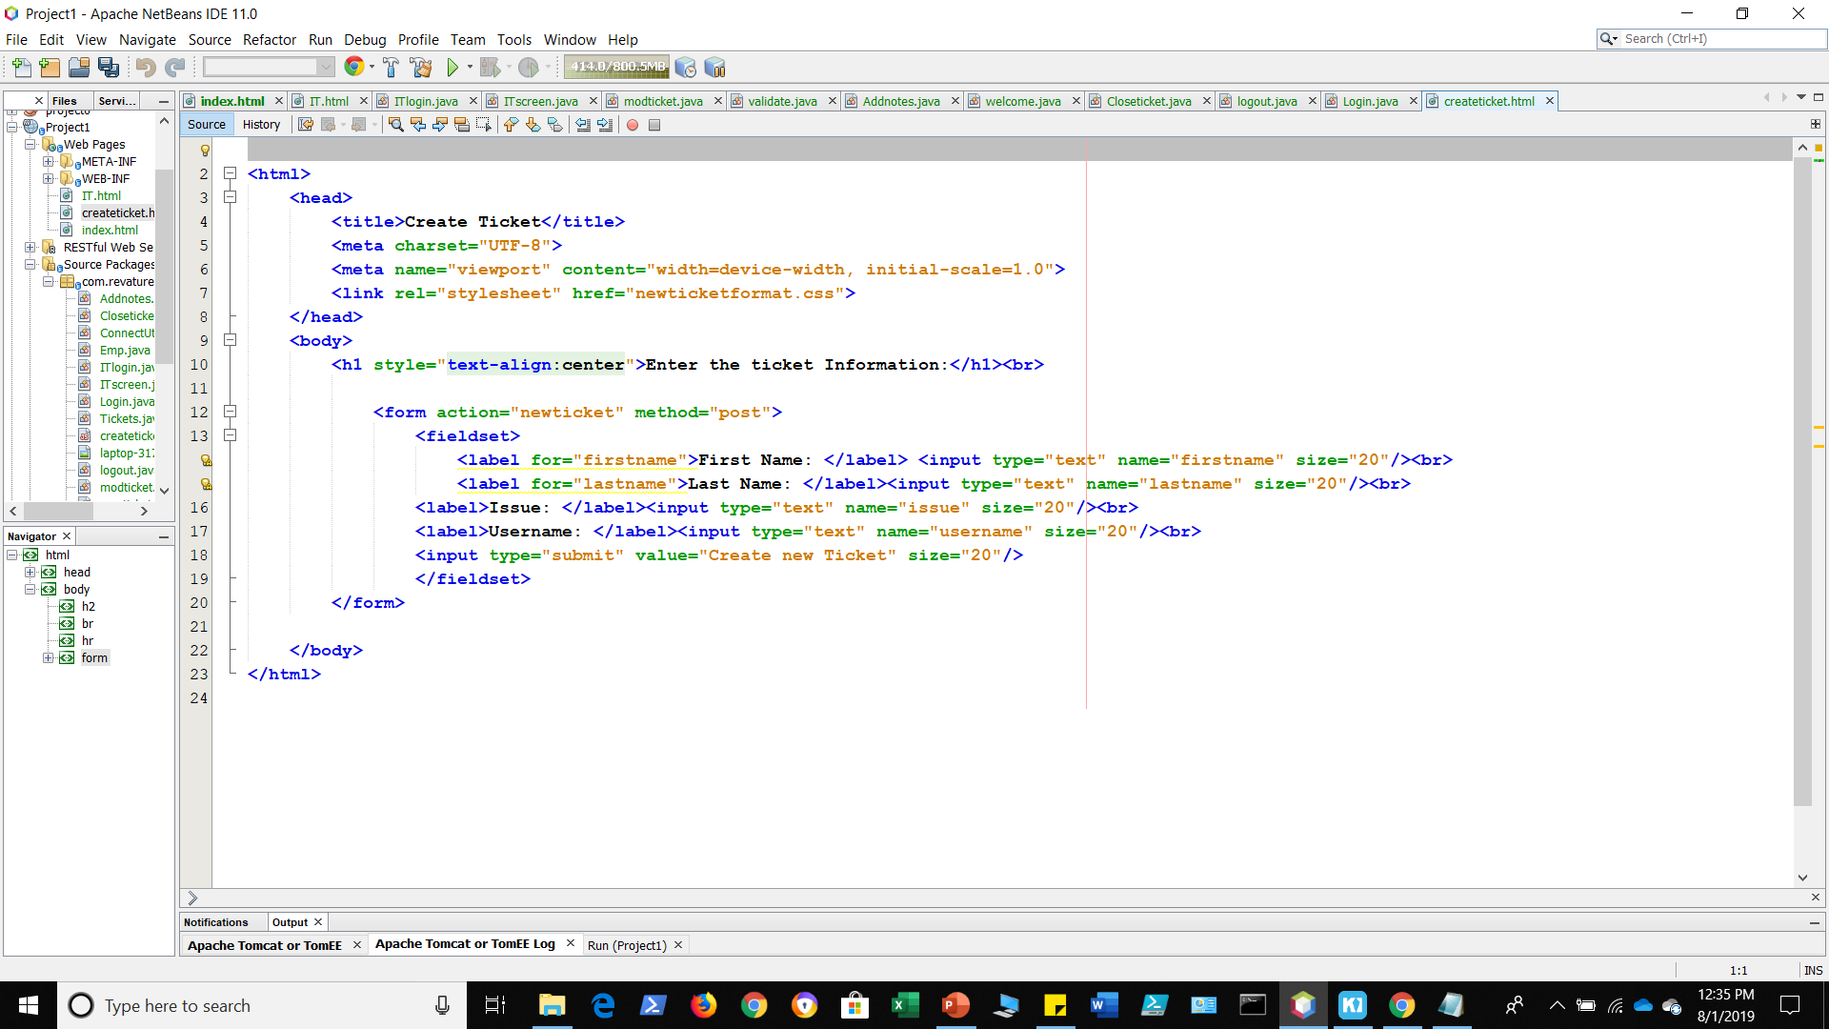
HTML-Ticket Creator

Slide 7
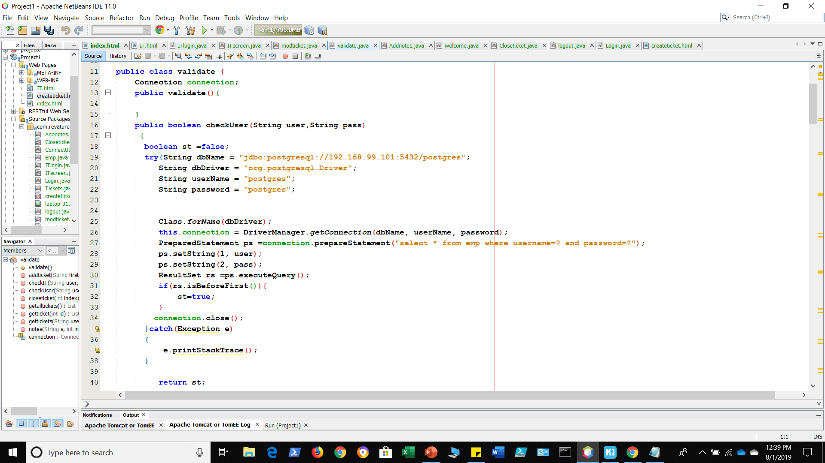
Java

Slide 8
Servlet
Login-user
Login-IT
Create Ticket
User Screen
IT user Screen
Logout
Create Ticket
Modify Ticket
Add notes

Slide 9
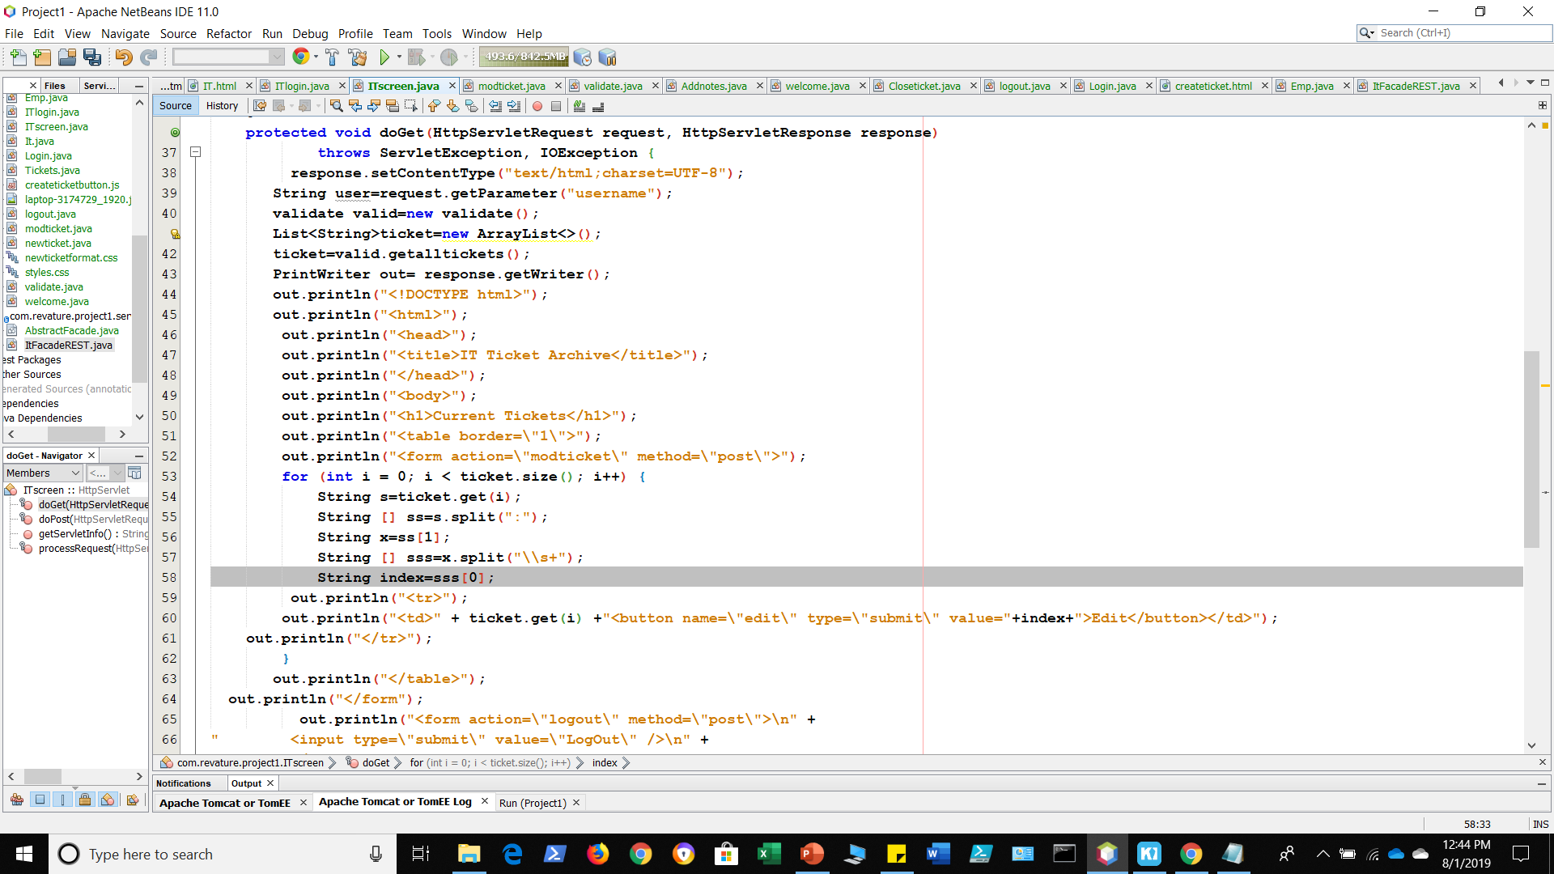
Example Servlet: IT Screen

Slide 10
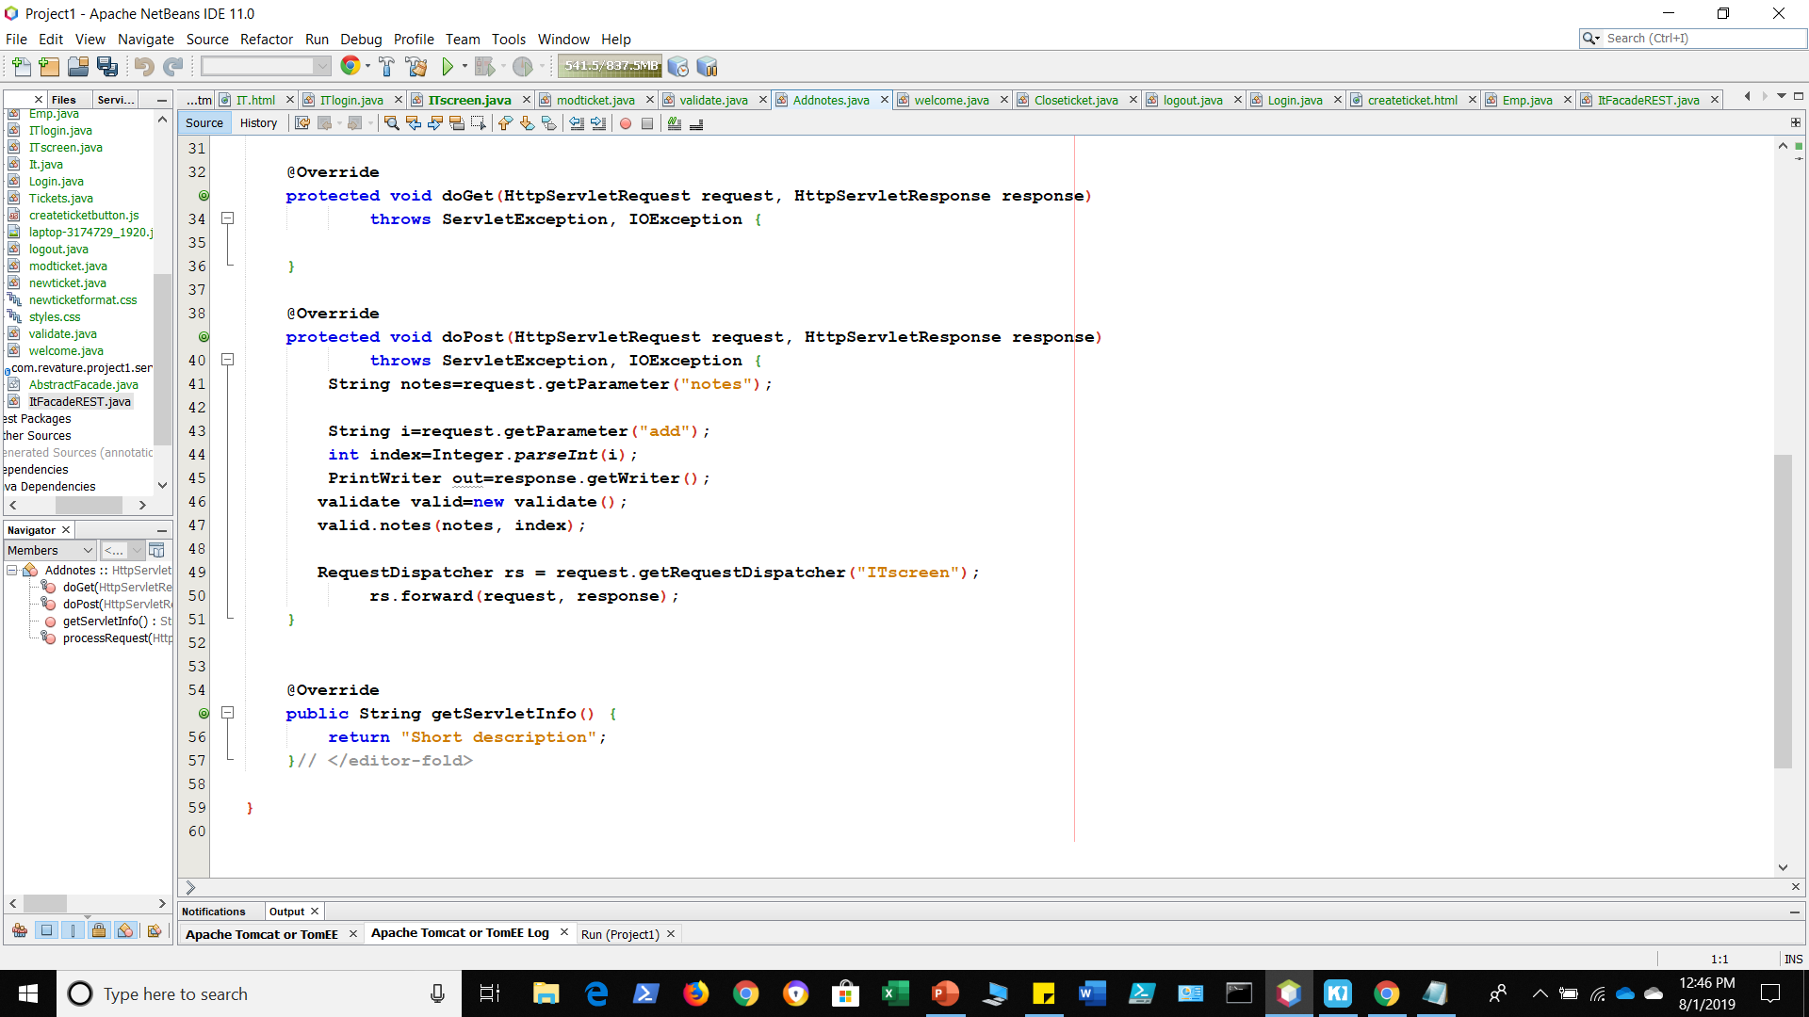
Example Servlet: Adding Notes

Slide 11
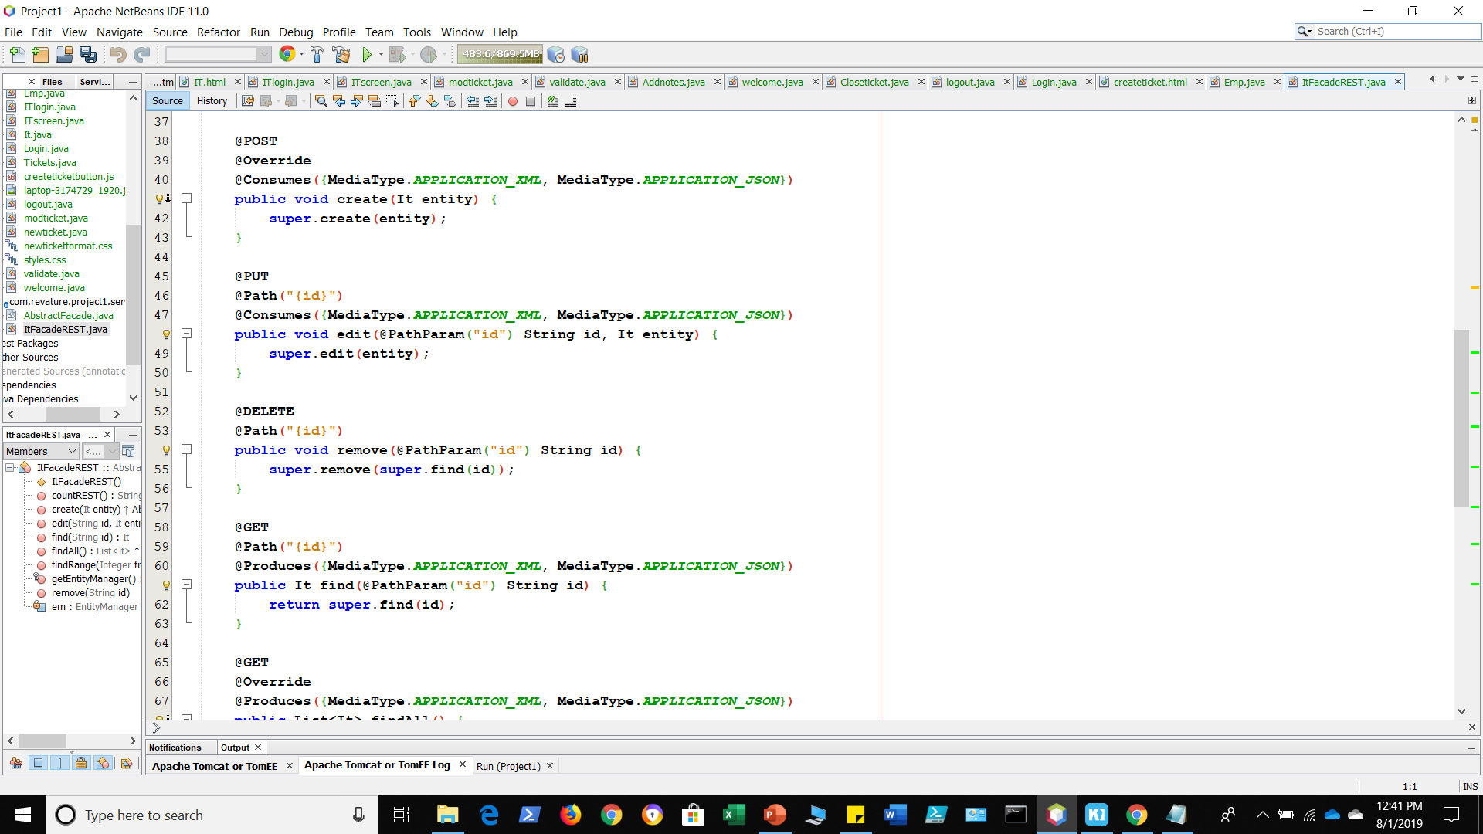
JAX-RS

